Slide 1
The Effect of Food Delivery Platforms on the Wage Difference after Job Status Changing
Shang-Chieh Wei

Slide 2
A Quick Review
This study uses the Manpower Utilization Quasi-Longitudinal Survey data to estimate the effect of food delivery platforms on the labor market.
I use the data from 2016 to 2019. Due to data limitation, I can only identify part-time workers, temporary workers and dispatched workers as atypical workers.
I use two different definitions of atypical employment to test the sensitivity of the estimation results.
The first definition of atypical workers includes part-time workers, temporary workers and dispatched workers.
Using the first definition, only those who are not only non-temporary and non-dispatched but also full-time are considered as typical workers.
The second definition of atypical workers excludes part-time workers so both typical and atypical workers are full-time workers.

Slide 5
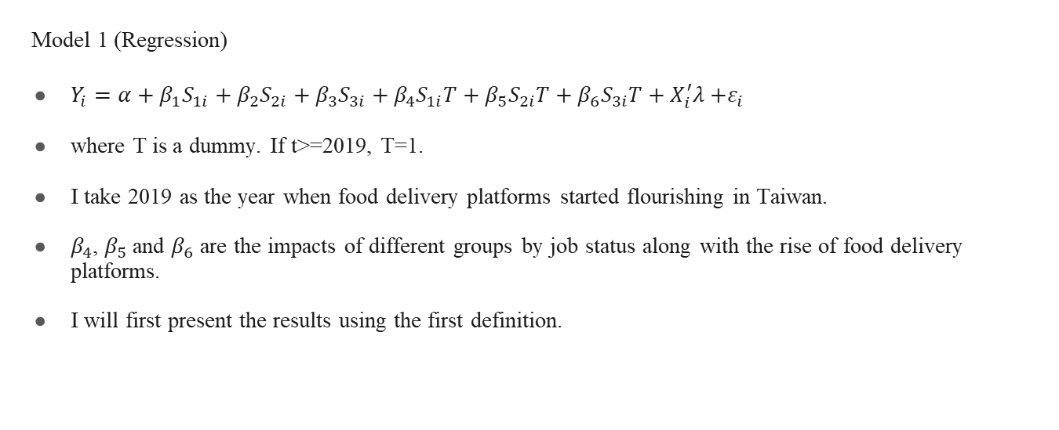
Empirical Design
Model 1 (Regression)
$Y_{i}=α+β_{1}S_{1i}+β_{2}S_{2i}+β_{3}S_{3i}+β_{4}S_{1i}T+β_{5}S_{2i}T+β_{6}S_{3i}T+X_{i}^{′}λ{+ε}_{i}$
where T is a dummy. If t>=2019, T=1.
I take 2019 as the year when food delivery platforms started flourishing in Taiwan.
$β_{4}$, $β_{5}$ and $β_{6}$ are the impacts of different groups by job status along with the rise of food delivery platforms.
I will first present the results using the first definition.

Slide 8
Remarks
Unexpectedly, using the first definition, workers who were in group S2 from 2018 to 2019 got more benefits from the change of job status.
Using the second definition, workers who were in group S1 from 2018 to 2019, enjoyed a significant income gain.
For workers who were in group S3 from 2018 to 2019, even though they still suffered from the change of job status, the pain was less severe since they also received a significant alleviation of income losses.
One possible explanation is there may exist trade-off between food delivery riders and part-time workers.

Slide 9
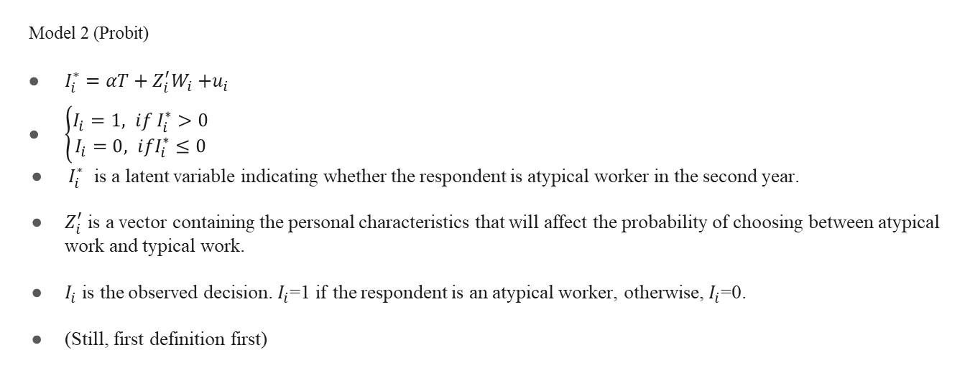
Empirical Design
Model 2 (Probit)
$I_{i}^{∗}=αT+Z_{i}^{′}W_{i}{+u}_{i}$
$\left\{\begin{aligned}I_{i}=1, if I_{i}^{∗}>0 \\ I_{i}=0, ifI_{i}^{∗}≤0\end{aligned}\right.$
$I_{i}^{∗}$ is a latent variable indicating whether the respondent is atypical worker in the second year.
$Z_{i}^{′}$ is a vector containing the personal characteristics that will affect the probability of choosing between atypical work and typical work.
$I_{i}$ is the observed decision. $I_{i}$=1 if the respondent is an atypical worker, otherwise, $I_{i}$=0.
(Still, first definition first)

Slide 12
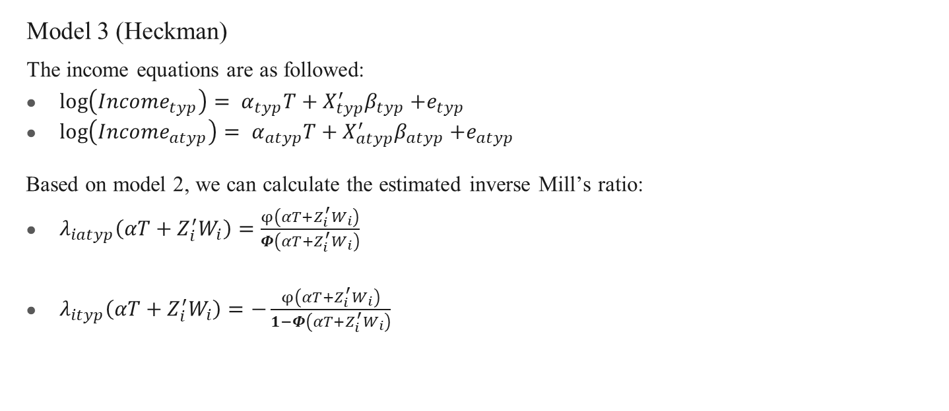
Empirical Design
Model 3 (Heckman)
The income equations are as followed:
$\log\left({Income}_{typ}\right)= α_{typ}T+X_{typ}^{′}β_{typ}{+e}_{typ}$
$\log\left({Income}_{atyp}\right)= α_{atyp}T+X_{atyp}^{′}β_{atyp}{+e}_{atyp}$
Based on model 2, we can calculate the estimated inverse Mill’s ratio:
$λ_{iatyp}\left(αT+Z_{i}^{′}W_{i}\right)=\frac{φ\left(αT+Z_{i}^{′}W_{i}\right)}{Φ\left(αT+Z_{i}^{′}W_{i}\right)}$
$λ_{ityp}\left(αT+Z_{i}^{′}W_{i}\right)=−\frac{φ\left(αT+Z_{i}^{′}W_{i}\right)}{1−Φ\left(αT+Z_{i}^{′}W_{i}\right)}$

Slide 13
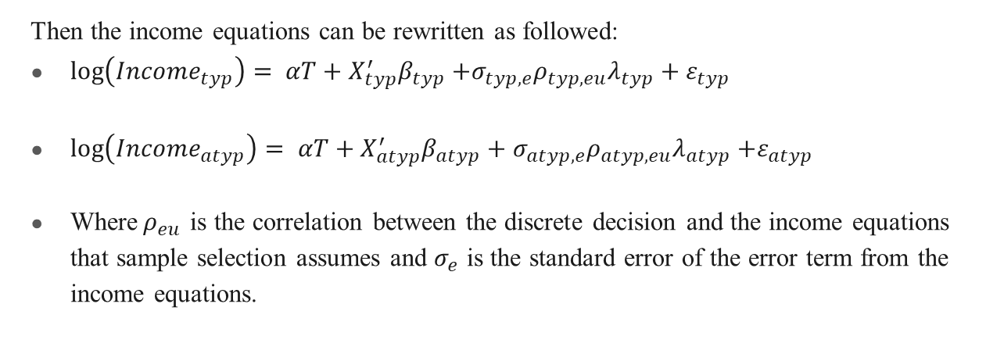
Empirical Design
Then the income equations can be rewritten as followed:
$\log\left({Income}_{typ}\right)= αT+X_{typ}^{′}β_{typ}{+{σ_{typ,e}ρ}_{typ,eu}λ_{typ}+ε}_{typ}$
$\log\left({Income}_{atyp}\right)= αT+X_{atyp}^{′}β_{atyp}+{σ_{atyp,e}ρ}_{atyp,eu}λ_{atyp}{+ε}_{atyp}$
Where$ρ_{eu}$ is the correlation between the discrete decision and the income equations that sample selection assumes and $σ_{e}$ is the standard error of the error term from the income equations.

Slide 14
The First Definition

Slide 15
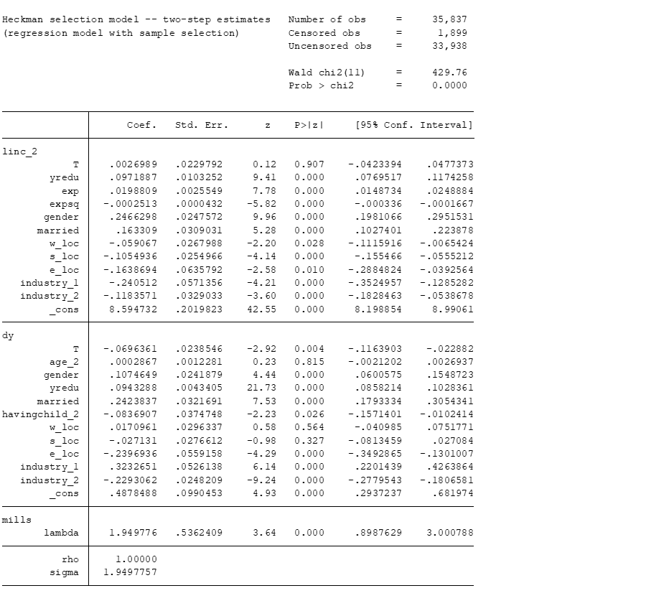
The First Definition

Slide 16
The Second Definition

Slide 17
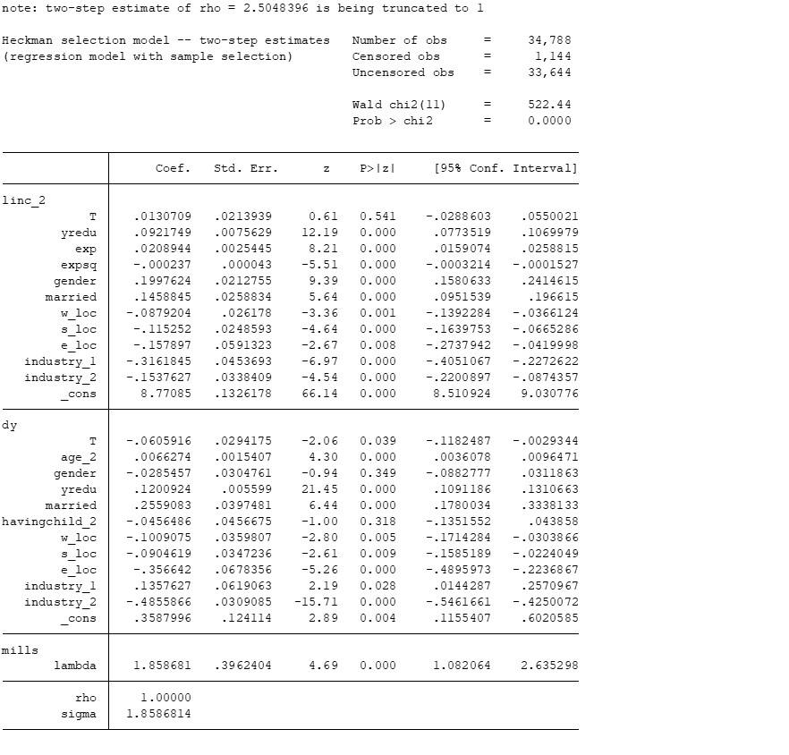
The Second Definition

Slide 18
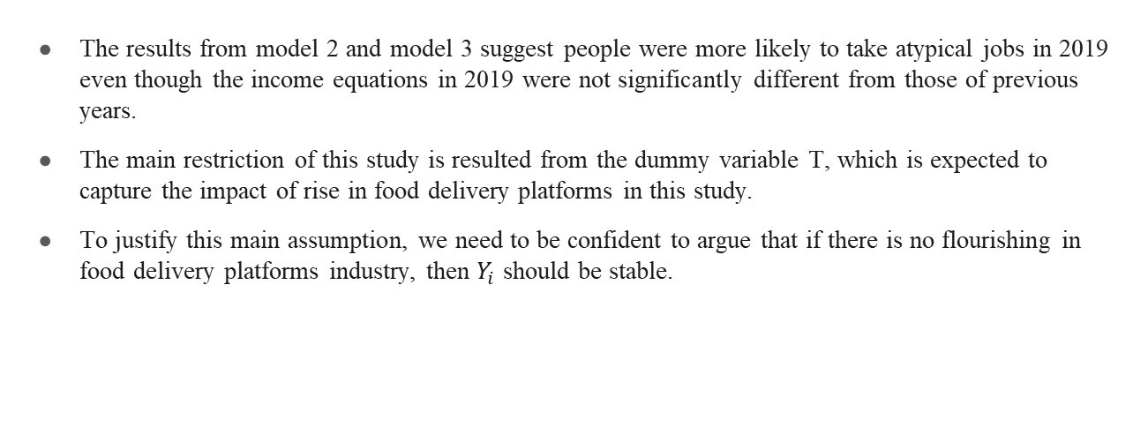
Discussion
The results from model 2 and model 3 suggest people were more likely to take atypical jobs in 2019 even though the income equations in 2019 were not significantly different from those of previous years.
The main restriction of this study is resulted from the dummy variable T, which is expected to capture the impact of rise in food delivery platforms in this study.
To justify this main assumption, we need to be confident to argue that if there is no flourishing in food delivery platforms industry, then $Y_{i}$ should be stable.

